Slide 1
UNIT 4 : Git BRANCHING AND MERGING

Slide 2
About Branching
Speaking of branches...a key feature of Git is branching. Think of the trunk of a tree as your main project. We create branches to separate our work for each task. It helps us isolate and work on one part of the project without directly impacting the main project until we are ready to merge it back

Slide 3
Why Use Branching?
By default, when we initialize a Git repository, Git creates a branch often called "main“/”master , though you may see it with other names. We'll refer to the primary branch as "master" throughout in our practical.

Slide 4
We create a separate branch for every issue or feature we work on. So as a feature is in progress, we commit our code to the branch for that feature.
Say, for example, we expect to spend a week working on an "Add feedback" feature that allows users to comment on a recipe. As we work, we commit our edits to the "Add feedback" branch.
Someone else on the team is working on updating the copyright notice on all of our site's pages. They commit their edits to the "Add copyright" branch.
Suddenly, we receive notification from our users that the login isn't working. We create a new branch to fix that issue without impacting any partially complete work.
When the code for the "login issue" branch is complete, we merge the branch back into the main branch. And optionally, we can delete the merged branch.

Slide 5
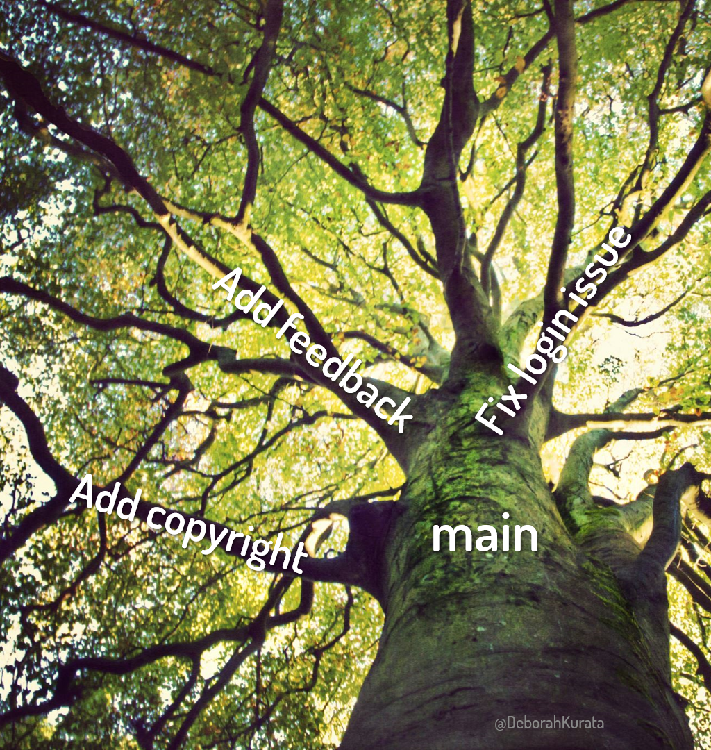
Structure of Branch

Slide 6
How to Create and Switch Branches in Git
Lets take one example :
Our team is building a website for collecting and managing Items. We create a repository for the project with Git. By default, it creates the primary project branch, often called "master".

Slide 7
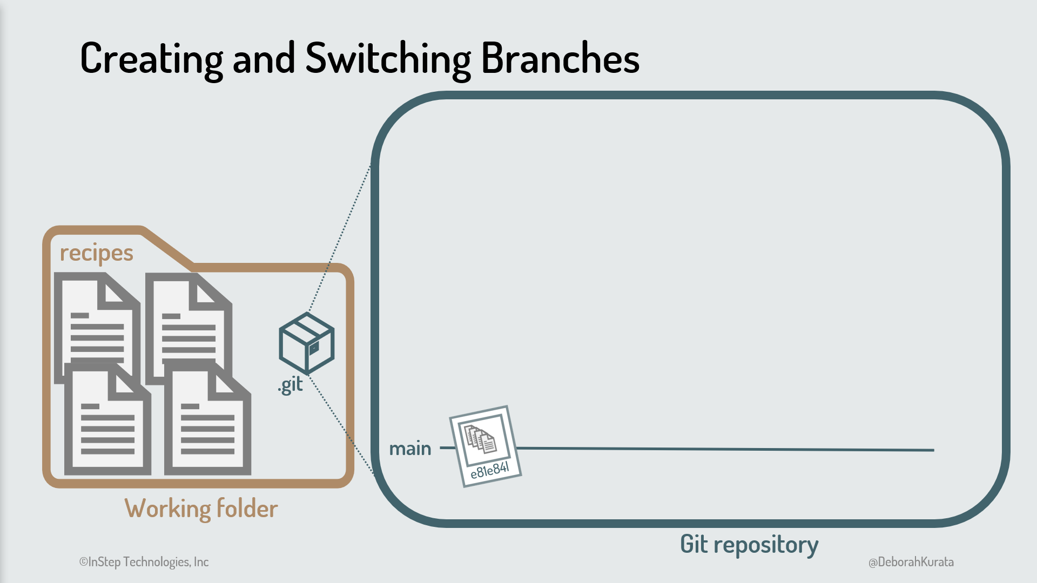

Slide 8
We start on a project to update the style of the website. We want to ensure our work on this task is isolated from our existing code, so we create a branch from the main branch.
Before we start work on the branch, we switch to that branch. Then we make changes for our task. We modify one file, then stage and commit to the branch. The result is shown in Figure in next .

Slide 9
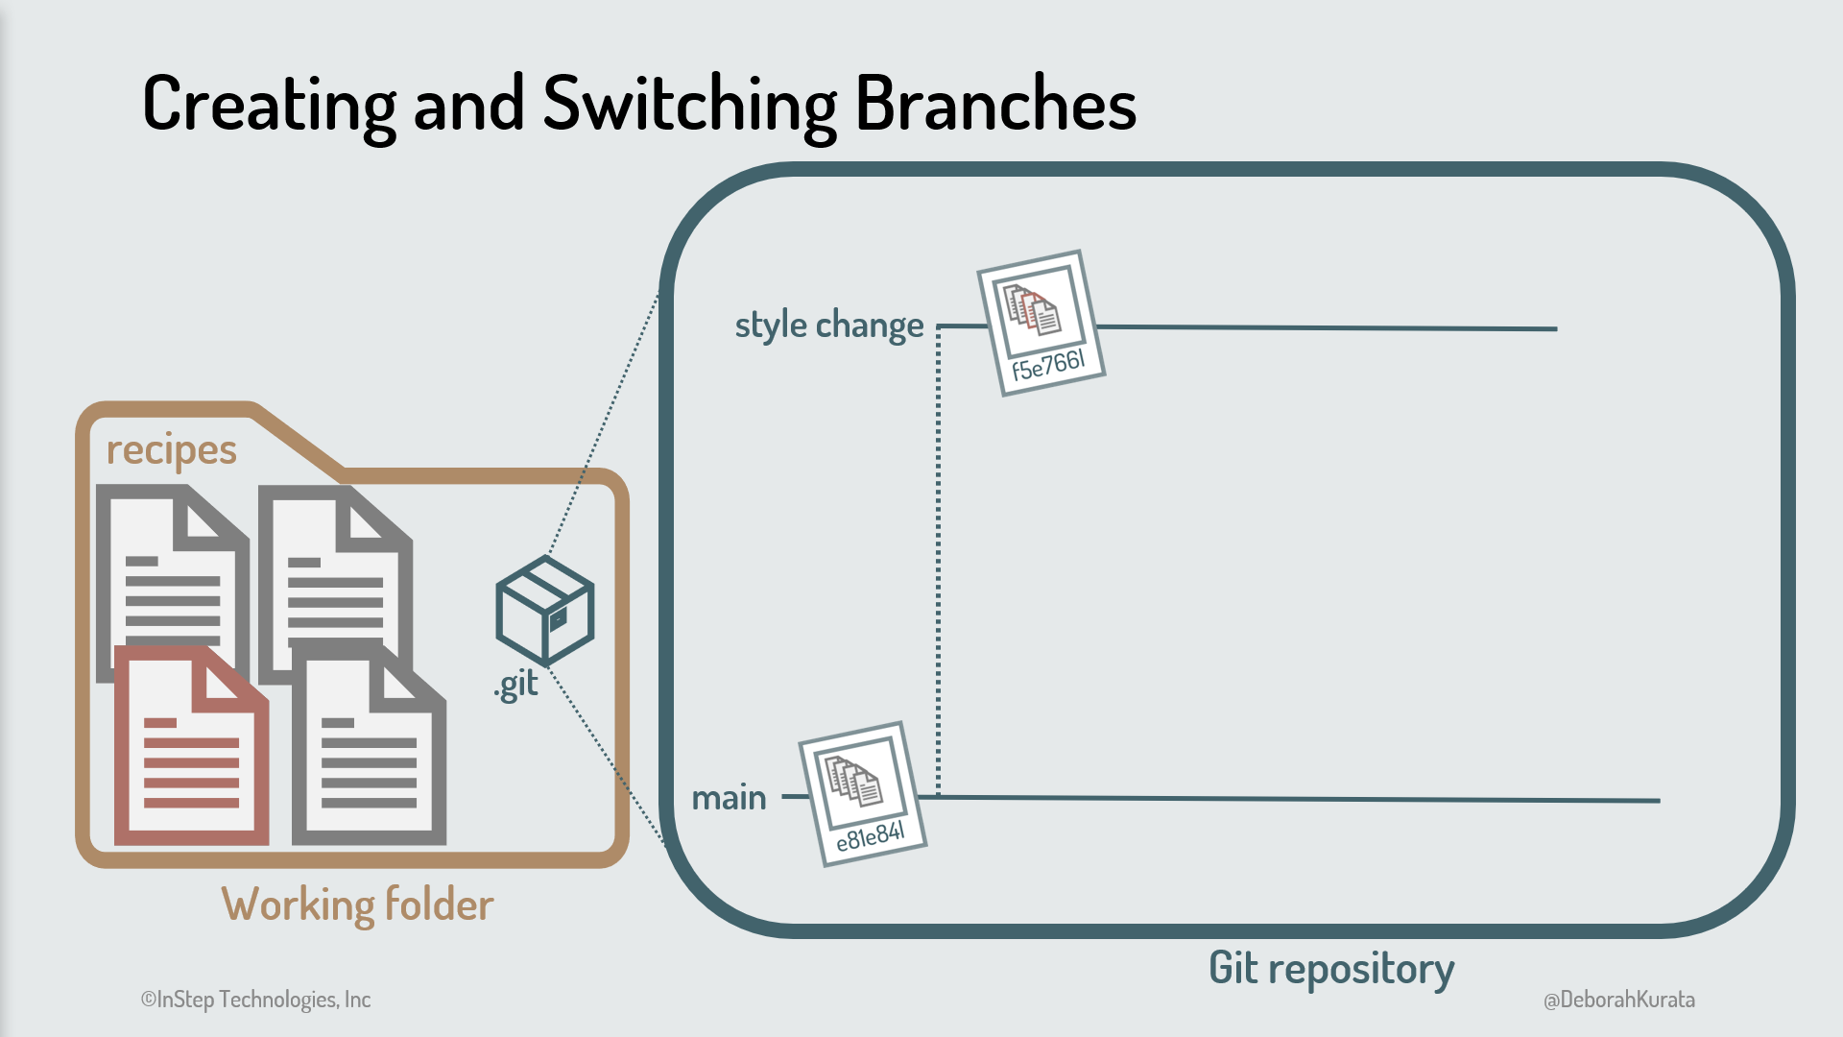

Slide 10
Any time you want to work on a branch, switch to that branch. Switching to a branch checks out that branch. And the code in our working folder is automatically changed to the code from the latest commit on that branch. All commits then occur on that checked out branch.
At this point, one of our users reports a login issue.
We have our style change partially complete, so we don't want to make our fix in that branch.
We instead create another branch from the main branch. Since we created it from the main branch, the initial code for this new branch is a copy of the main branch code. It has none of our style changes.
When we switch to that branch, our working folder reflects the code from that branch. We've basically reset our working folder to the code for the new branch.

Slide 11
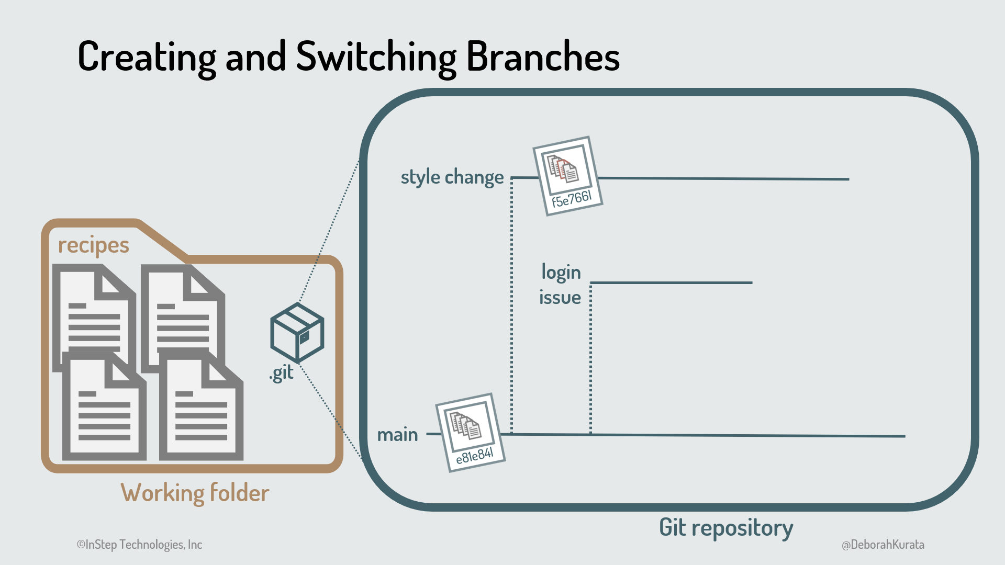

Slide 12
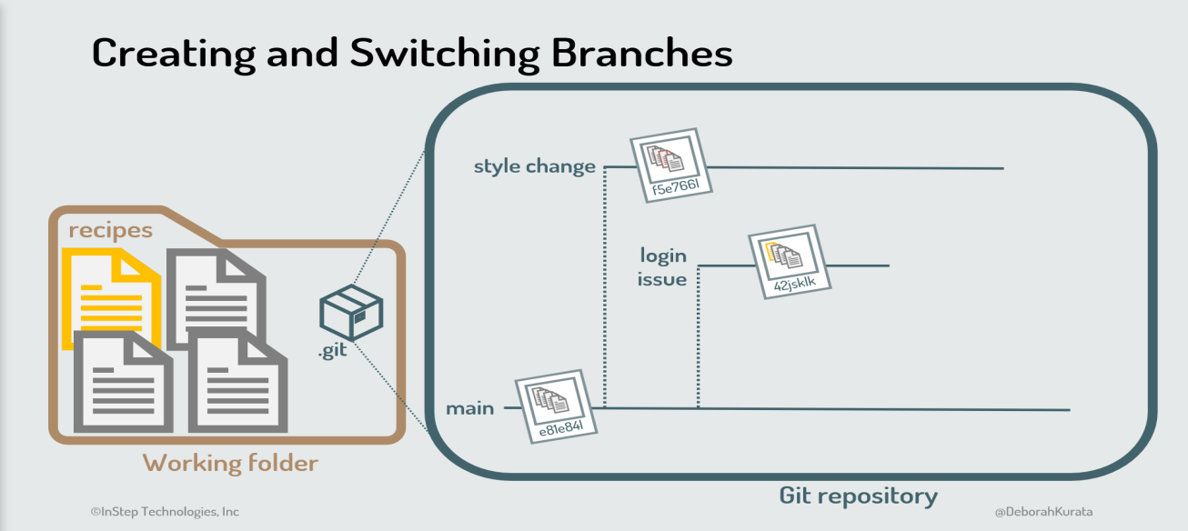
We then fix the login issue in this new branch, modifying one file and staging and committing the change as shown in Figure

Slide 13

How to Merge Branches in Git

Slide 14
When our login fix is complete, we merge the "login issue" branch back into the main branch. The fix then becomes part of our main code as shown in Figure 6. Once the branch is merged, we can delete it.

Slide 15
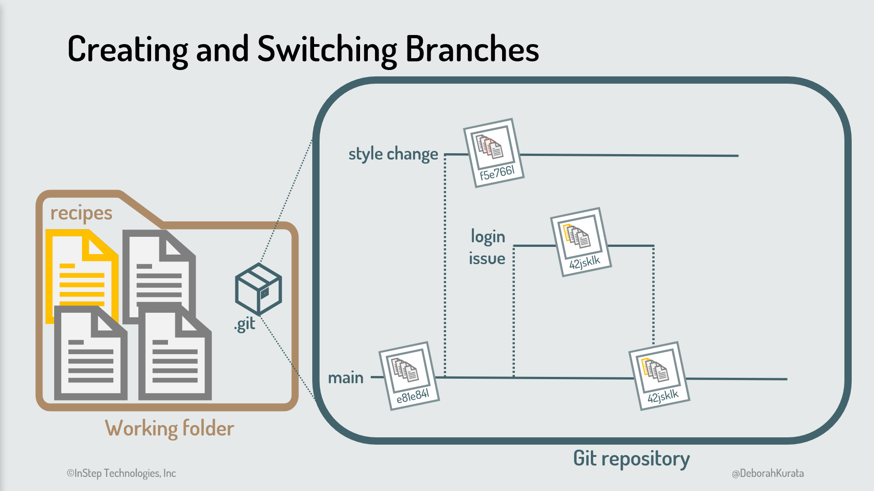

Slide 16
Now we switch back to the "style change" branch to finish our modifications. The code in our working folder is automatically switched to the code from the last commit in that style change
We make more style changes and stage and commit those changes to the "style change" branch

Slide 17
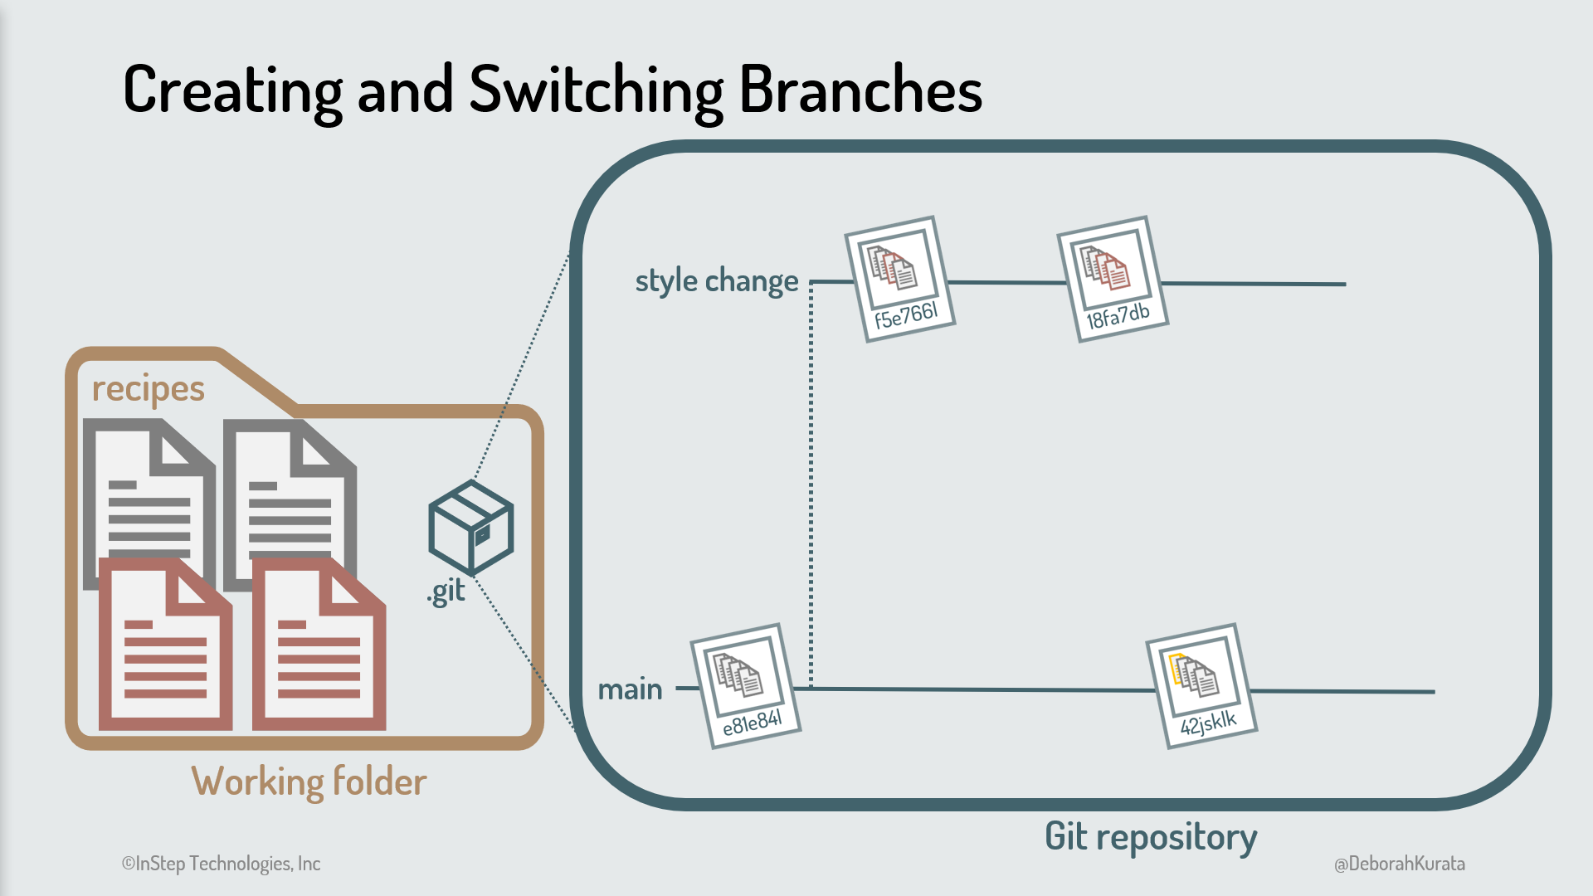

Slide 18
But wait...our main code branch now has our login fix, but our "style change" branch does not.
At some point, before the "style change" branch is merged into main, we need to pull in the login change from main.
We merge the latest changes from our main branch into the "style change" branch, resolving any merge conflicts. This creates another commit as shown in Figure. Notice that our working folder now reflects both sets of changes.

Slide 19
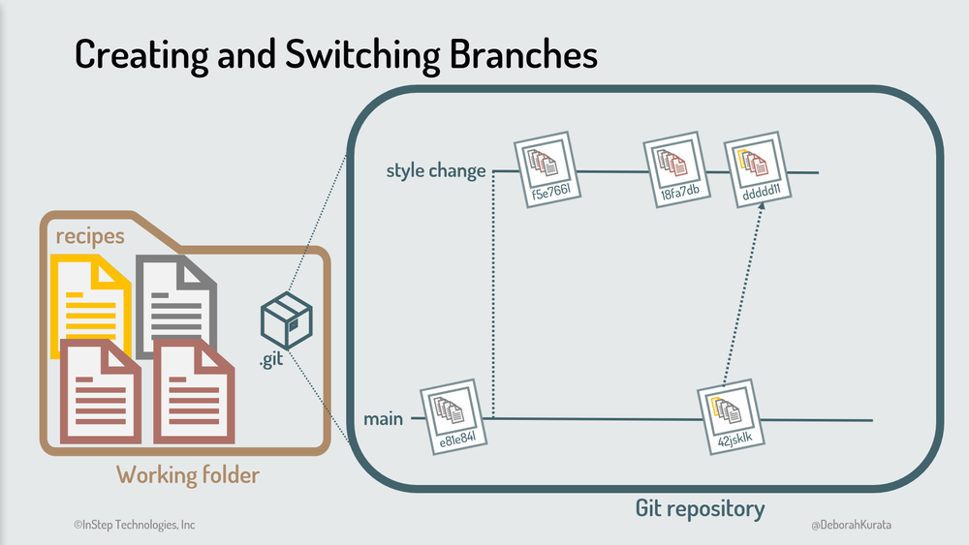

Slide 20
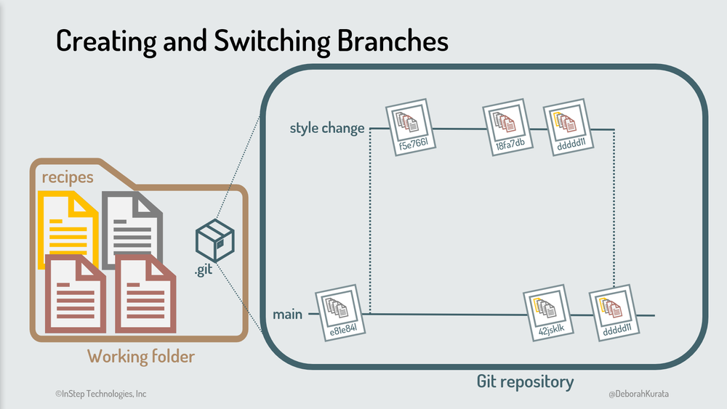
When the style change is complete, we merge the "style change" branch back into the main branch.
Now our main branch has all of our changes, depicted in Figure And we can delete our "style change" branch.

Slide 21
THANK You
NOW we will implement this Practically in GIT

Slide 22
What is git rebase?
Rebasing is the process of moving or combining a sequence of commits to a new base commit. Rebasing is most useful and easily visualized in the context of a feature branching workflow. The general process can be visualized as the following:

Slide 23
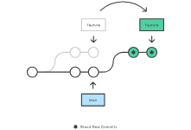

Slide 24
From a content perspective, rebasing is changing the base of your branch from one commit to another making it appear as if you'd created your branch from a different commit. Internally, Git accomplishes this by creating new commits and applying them to the specified base. It's very important to understand that even though the branch looks the same, it's composed of entirely new commits.

Slide 25
The primary reason for rebasing is to maintain a linear project history. For example, consider a situation where the main branch has progressed since you started working on a feature branch. You want to get the latest updates to the main branch in your feature branch, but you want to keep your branch's history clean so it appears as if you've been working off the latest main branch. This gives the later benefit of a clean merge of your feature branch back into the main branch.

Slide 26
A bug is identified in the main branch. A feature that was working successfully is now broken.
A developer examines the history of the main branch using git log
The developer can not identify when the bug was introduced using git log so the developer executes a git bisect.
Because the git history is clean, git bisect has a refined set of commits to compare when looking for the regression.

Slide 27
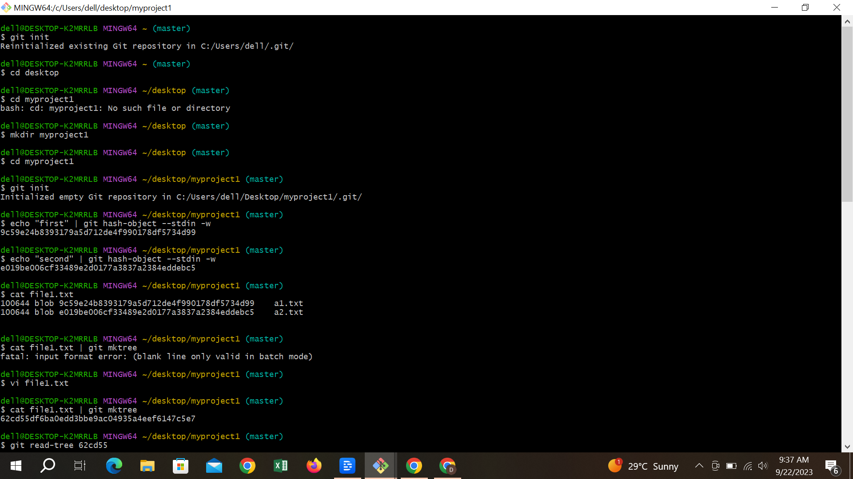

Slide 28
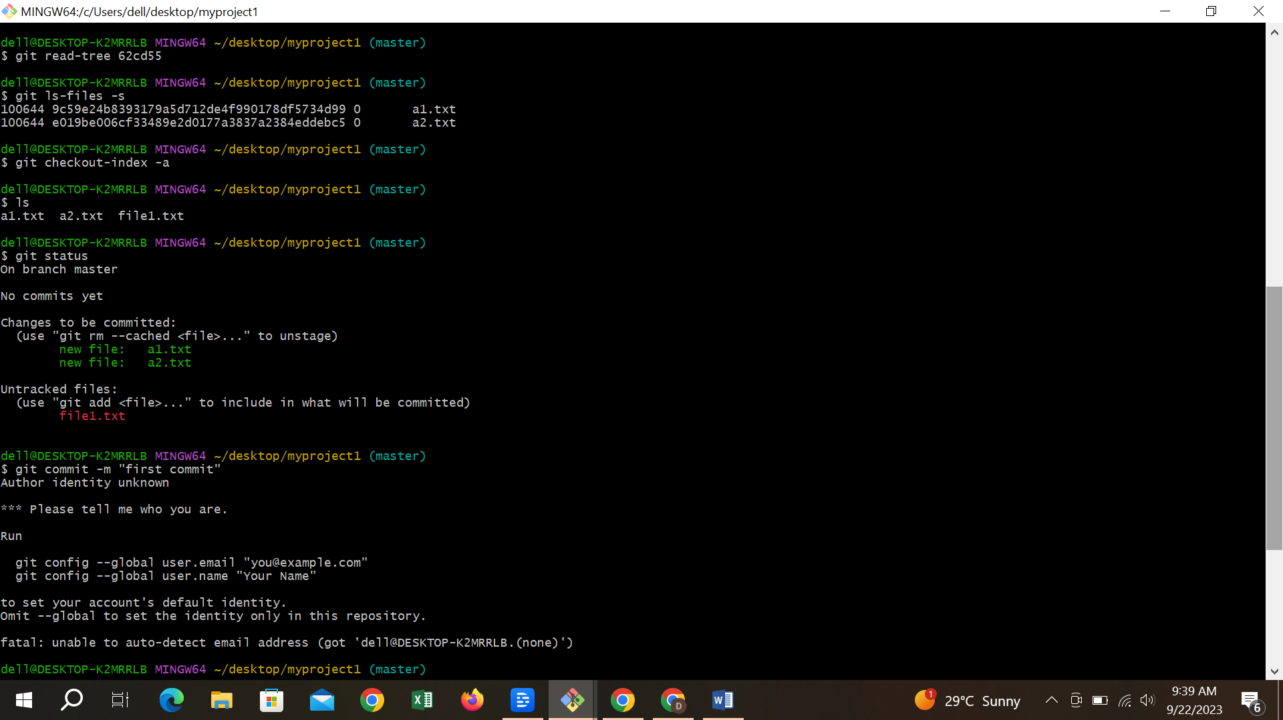

Slide 29
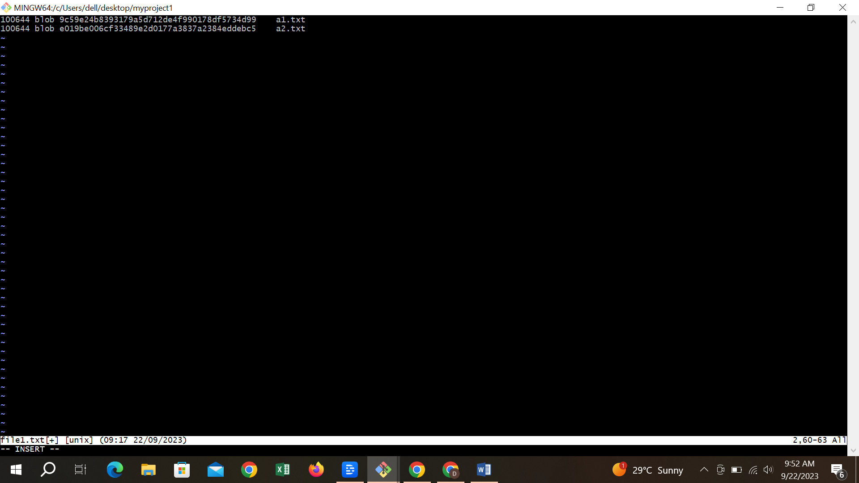

Slide 30
